Slide 1
Mobile-CORD Plans for 2H `2016

Slide 2
M-CORD Roadmap
Notes:
5G Requ
5G base station high bandwidth RF filter test piece R&D
5. 5G low frequency (<6GHz) wide-area network solution study and trial system development
6. 5G low power, massive connectivity solution study and trial system development
7. 5G high frequency system solution study and trial system development
8. 5G high density network deployment technology study and trial system development
9. 5G new Multiple Access Coding (PHY layer) study and verification
10. User centric 5G wireless access network architecture and key technologies study
11. 5G-based high accuracy indoor location service technology study
12. Autonomous driving research and demonstration irements: Enormous amounts of connected devices, flexible air interfaces, “always-online” capabilities and high energy efficiency.

Slide 3
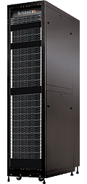
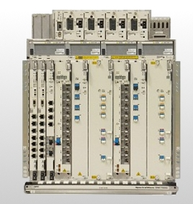
M-CORD Focus Areas
SDN Control Plane - ONOS
NFV Orchestration w/XOS
1
2
3
Disaggregated/Virtualized RAN
Disaggregated
/Virtualized
EPC
Mobile Edge
Services
+
BBU, RRU
Front-haul
MME, SGW, PGW
Caching, SON, IoT, VR/AR
Commodity servers, switches, network access

Slide 4
Disaggregated and Virtualized RAN
1
RAN Slicing
Policy driven - Time, Location, UE category, Service, etc.
Resource management and isolation between slices
RAN selection of Core network entity
Front-haul slicing – based on simple tag such as VLAN
Support for Multi-RATs
Observability and Analytics
Integration with A-CORD
Real-time vProbes
Closed loop analytics
Example use cases: Open SON, Root cause analysis
Flexible Disaggregation
Horizontal – Split architecture depending on front-haul and latency requirement
Vertical – Control-plane / Data-plane
RAN + Front-haul + Core slicing should be coordinated

Slide 5
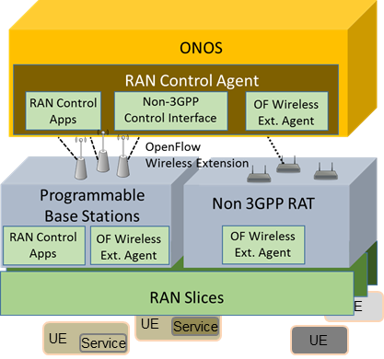
Implementation and Demo
1
RAN Slicing
RAN Slicing App. in ONOS talks to RAN agent through OF-extension
Policy driven slicing – UE, Time, Location, Services
Service classification is implemented by using tagging such as ‘Network cookies’
RAN Slicing
Application
RAN Slicing
Portal
M-CORD Control Platform
ONOS
XOS
OF extension
UE
vBBU
Slicing
Agent
vBBU
UE
UE
Slicing
Agent
Service
UE
RRH
Service
Sliced Set of Radio Resource Blocks
Mobile edge
Centralized Core
Demo
Different UEs and Services experience different QoS based on the slice policy

Slide 6
Implementation and Demo
1
Observability and Analytics
Observability of vBBU
Integration of SON with A-CORD
- Expand information set can be acquired from vBBUs
SON
Application
SON
Portal
M-CORD Control Platform
ONOS
XOS
vBBU
SON
Agent
vBBU
SON
Agent
RRH
Mobile edge
Centralized Core
Demo
SON application collects and sends RAN information through M-CORD platform

Slide 7
Disaggregated and Virtualized EPC
2
Core Slicing
Flexible allocation of VMs of EPC components and Service functions per slices
Slicing includes both Control-plane and Data-plane
Isolation, QoS, customized security per slices
※ Coordinated with RAN and Fabric slicing (E2E slicing)
Observability and Analytics
Integration with A-CORD
Observe – Slice utilization, EPC VMs resource utilization
Closed Loop Analytics
Example Use Cases: Active testing, Dynamic resource allocation for slices
Connectionless
Non-GTP based data forwarding model
Phase 1 for static IoT devices, Phase 2 with mobility support
※ should support connectionless for RAN when possible
Seek and Integrate Open EPC building blocks
Notes:
How to support mobility across the slices?

Slide 8
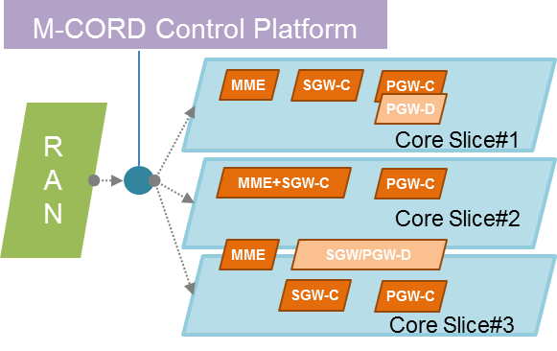
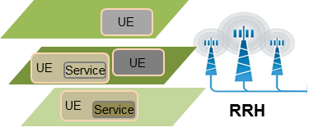
Implementation and Demo
2
Core Slicing
Dynamic assignment of EPC resources to set up slices
- Resources can be dedicated or shared btw slices
RAN communicate with M-CORD control to select appropriate Core slice
E2E Slicing
Application
Slicing
Portal
M-CORD Control Platform
ONOS
XOS
vBBU
Edge
Core
Slice
Edge
Services
Central
Core
Slice
Slicing
Agent
Back
-haul
vEPC
vBBU
Edge
Core
Slice
Slicing
Agent
Mobile edge
Centralized Core
Demo
M-CORD control app directs UE traffic flow form RAN to desired Core slice

Slide 9
Implementation and Demo
2
Observability and Analytics
Use real-time programmable vProbes
Enable flow type based Core Slicing by identifying application
Enable monitoring, DPI, mirroring of packets
SmartNIC Programming Application
M-CORD Control Platform
ONOS
XOS
EPC
VMs
Service
VMs
Back
-haul
Central
Core
Slice
EPC
VMs
vEPC
Mobile edge
Centralized Core
Show collections of vEPC stats such as packet inter-arrival time
Show service based Core slicing
Demo

Slide 10
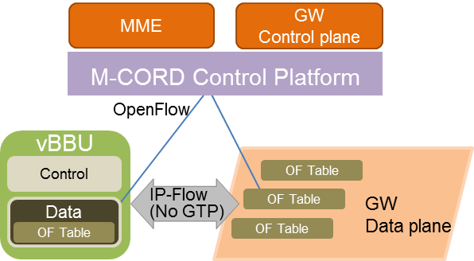
Implementation and Demo
2
Connectionless
Disaggregate eNB/SGW/PGW components to enable centralized entity manage new (non-GTP) data plane
eNB data plane and service gateway data plane are controlled by SDN controller
Get rid of GTP-C signaling to set up GTP tunnels, replace with OF rules in data path element
Connection Service
Application
MME
GW-C
M-CORD Control Platform
ONOS
XOS
OpenFlow
vBBU
Service GW
Data Plane
IoT
Services
App
vBBU
Data
Plane
Data
Plane
OF Table
RRH
OF Table
Mobile edge
Demo
Static and cellular IoT Devices are serviced by Non-GTP based network.
Show there is no SGW, PGW. Instead, SDN controllable ‘Service GW Data plane’ exist

Slide 11
Mobile Edge Services
3
CDN
AR/VR
Public safety
m-Health
Take advantages of
Proximity (Mobile Edge)
RAN/Core slicing
Resource management
Tagging mechanism
Service steering

Slide 12
Implementation and Demo
3
CDN
Support serving locally cached CDN content for better QoE
Support CDN data traffic demand by scaling EPC components
Utilize Slicing to provide policy-based QoE
AR/VR
Support customized Augmented Reality and/or Virtual Reality services in a targeted area
Utilize Slicing to meet the high throughput requirement
Examples : AR Gaming, VR museum - Solution partners are TBD
Demo
Demo benefits of EPC scaling for CDN application
Demo
Demo AR/VR applications with enhanced QoE
Public Safety
Utilize Slicing to support for ‘xpose’, an app for public safety combined with streaming and enable
Free cellular access in case of “panic” mode
SLA and QoS for non-panic mode
Implement steering mechanism to forward the emergency traffic to the appropriate destination (such as police, fire station)
m-Health
Utilize RAN Slicing to support priority by dedicating resources for critical m-Health application
Examples : Remote medical treatment app. - Solution partner is TBD
Provide free xpose service for panic mode
Forward fire event to the fire station
Demo an m-Health app. running with stable QoS under congestion situation
Demo
Demo

Slide 13
M-CORD Lite
Notes:
5G Requ
5G base station high bandwidth RF filter test piece R&D
5. 5G low frequency (<6GHz) wide-area network solution study and trial system development
6. 5G low power, massive connectivity solution study and trial system development
7. 5G high frequency system solution study and trial system development
8. 5G high density network deployment technology study and trial system development
9. 5G new Multiple Access Coding (PHY layer) study and verification
10. User centric 5G wireless access network architecture and key technologies study
11. 5G-based high accuracy indoor location service technology study
12. Autonomous driving research and demonstration irements: Enormous amounts of connected devices, flexible air interfaces, “always-online” capabilities and high energy efficiency.

Slide 14
Goals, Functionalities, Packaging
Goals
Build a portable, inexpensive, & easy to replicate M-CORD for development, experimentation, demonstration
To enable experimental deployments in support of acceleration of 5G
Functionalities
Packaging and Form factors
No more than quarter racks or desktop environment
Run on standard power
Appropriate for office environment
Desirable 10k
Should support 16~32 (?) UEs
Disaggregated and Virtualized RAN
Disaggregated and Virtualized EPC
Mobile Edge Applications
+
ONOS, Docker/Container, XOS
OF enabled networking (HW & SW switches)

Slide 15
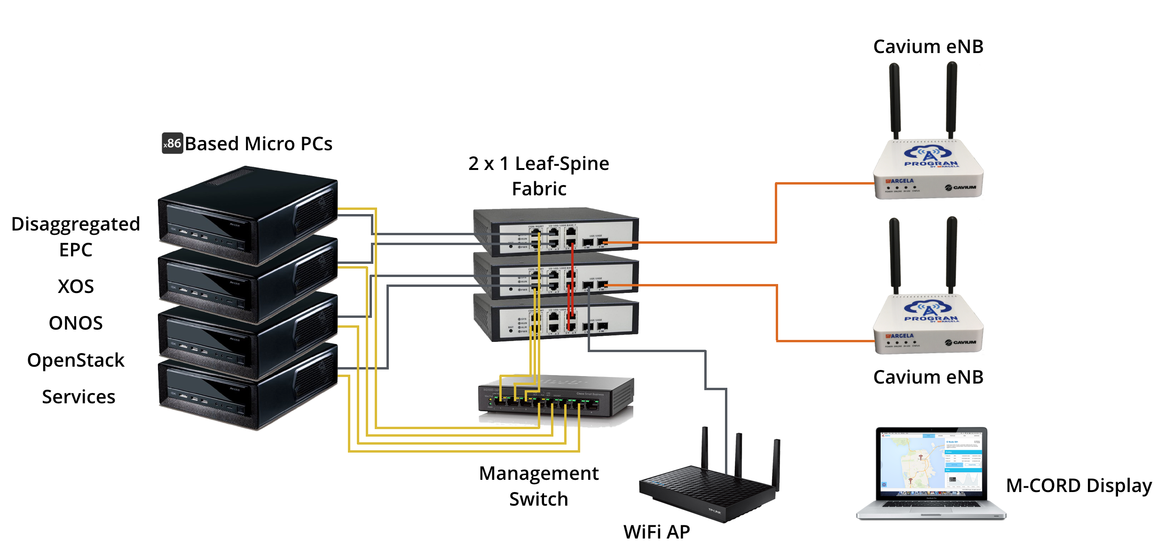
Solution Candidate (1)

Slide 16
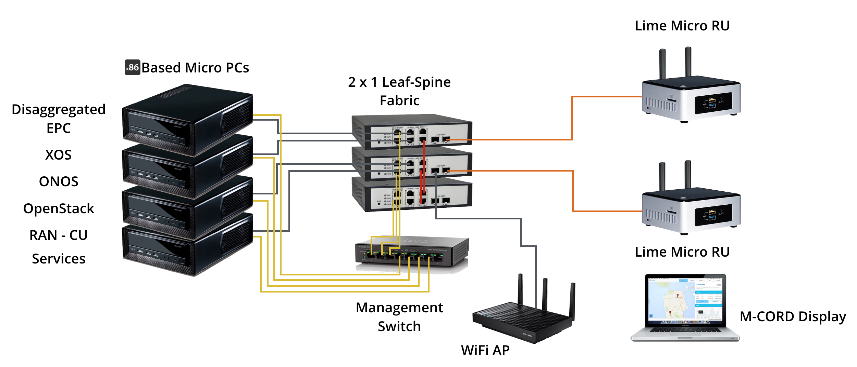
Solution Candidate (2)

Slide 17
M-CORD in Portable Rack

Slide 18
M-CORD Implementation Options
 | M-CORD Lite |  | M-CORD Rack
TYPE | with Cavium | with Intel | Portable Rack | Carrier Grade full rack
CONNECTIVITY | OpenFlow Switch | OpenFlow Switch | COTS, Leaf & Spine | Carrier Grad, Leaf & Spine
# OF SERVERS | 4 x86 + 1 ARM | 5 x 86 | 5 x86 + 1 ARM | 5 x86 + 1 ARM
CPU | 16-core Intel, 4 core ARM | 16-core Intel, 4 core ARM | 24-core Intel, 48 core ARM | 24-core Intel, 48 core ARM
RAN | Cavium vBBU + RRH | Intel vBBU + USRP RRH | Cavium vBBU + RRH | Intel vBBU + USRP RRH
EPC | ? | ? | Netcracker, Radisys, Quortus vEPC | Netcracker, Radisys, vEPC
UE CAPACITY | 16 UEs per RRH | ? | 16 UEs per RRH | 16 UEs per RRH
# OF eNBs | Small | Small | Medium | Large
Power consumption | 150 W X 6 = 900 W | 150 W X 6 = 900 W | 1000 W * 6 = 6 KW | ~14-20 kW
Weight | 6 x 6 = 36 lbs | 6 x 6 = 36 lbs | Max 540 lbs
Size | (3.8”*6) 22.8” x 8.7” x 12.9” | (3.8”*6) 22.8” x 8.7” x 12.9” | 25’’ x 21.5’’ x 31.1’’ (12U Box) | 14~18U
Features | Virtualization, Disaggregation, Slicing | Virtualization, Disaggregation, Connectionless, Slicing (?) | Virtualization, Disaggregation, Slicing, Multi-RAT | Virtualization, Disaggregation, Slicing, Multi-RAT
Apps. | Streaming, IoT, AR/VR | IoT, Streaming, AR/VR | IoT, Streaming, AR/VR | IoT, Streaming, AR/VR
Approximate Cost | 20 K* | 20 K* | 40 K*
Notes:
How to do it and what we will demonstrate

Slide 19
Software on M-CORD Lite Platform
Consensus on M-CORD Lite platform - Align with CORD
Acquire H/W → Assemble → Test
Create the Software Stacks ( Standard CORD Stack + RAN + EPC)
 | Components providers | Services | Timeline
Plan 1 | Cavium, Argela, Quortus | Example ONS Services | 1st Demo in Oct.
Plan 2 | Radisys, Intel, Argela, | Example ONS Services | TBD
Notes:
How to support mobility across the slices?

Slide 20
M-CORD Distribution
Build Process is open sources ( Lead: On.lab)
Platform Software is open sourced and based on latest releases
ONOS, XOS, OpenStack, Docker, Fabric , Portals, Test Tools
VNF binary license distribution for development and experimentation
Need permission from all VNF partners
How to synch up with CORD distribution?
How does M-CORD contribute back to CORD distribution?
Notes:
Matrix of schedule & vendors

Slide 21
Potential Partners/Collaborators
Notes:
Full CORD support
Fabric enabled
HA
Performance and scale
Lower latency support
Diverse services

Slide 22
RAN
Partners/ Collaborators | Functionalities | Comments
Cavium / Argela | RAN + slicing Observability & Analytics | - Cavium: smaller form factor for M-CORD Lite - Need to implement Service based slicing solution
Intel / Argela | RAN + slicing Observability & Analytics | - Can we get Intel to commit? - Can Argela do Slicing on Intel platform?
TBD | Front-haul slicing | - Can Nokia or Fujitsu do this?
OAI | Open Air Interface | - OAI stack needs to be matured and virtualized - Argela and OAI should support slicing
Radisys |  | - Candidate
Amerisoft |  | - Candidate

Slide 23
EPC
Partners/ Collaborators | Functionality | Comment
Netcracker | EPC building blocks | - Require separate OpenStack - Larger server requirements are problem for m-cord lite - Integration with XOS is a challenge
Radisys | EPC building blocks Connectionless Analytics | - Willing to open source so they can be a default partner? - Can their building blocks be full functional ?
Intel | EPC for Test-beds Slicing Analytics | - Can they implement EPC functions for Connectionless POC?
Open EPC | EPC building blocks | - No direct relationship yet
Quortus | EPC building blocks Core Slicing | - Virtualized and disaggregated ?
Cisco |  | - Candidate

Slide 24
Services
Partners/ Collaborators | Functionality | Comments
Akamai | CDN | M-CORD integration
xpose | Public Safety | Adjust Slices to deal with disasters / Panic
VSee | m-Health | Remote Control of Medical devices
Lime Microsystems | SDR under control of ONOS | Public Safety use cases

Slide 25
Testing, Integration and other features
Partners/ Collaborators | Functionalities | Comments
Tech-Mahindra | Testing, Performance
Cobham | Test emulator
Ercom | Agile test environment
Radisys | M-CORD integrator
Viavi | E2E monitoring and analytics
Netronome Cavium | Programmable analytics & Classifier (adjunct NIC) | - OVS and Analytics
Xilinx | Acceleration as a Service

Slide 26
Next Steps: Schedule and Milestones
Continue to flesh out the details
Get commitments from Partners & Collaborators
- Contribution of building blocks ( Open Source)
- Resources in terms of developers and program managers
Schedule
-2 Weeks to get all the commitments
- Finalize the roadmap and plan to be presented at CORD summit (29th Jul 2016)
- First demonstration in October 2016 at an event
- Final demonstration to the Board and possibly at an event in December 2016
Notes:
Matrix of schedule & vendors

Slide 27
Backups

Slide 28
Mobile-CORD Enable 5G with/on CORD
ONOS/CORD Partnership
http://opencord.org/
Notes:
Thank you!
We are here to tell you about the ONOS Partnership
We have been working with Dan and interacting with Petri for almost a year and good to have the opportunity to talk to the larger team.
Our mission is to accelerate SDN and NFV deployments in service provider networks and help them monetize SDN and NFV
With open source platforms and solutions

Slide 29
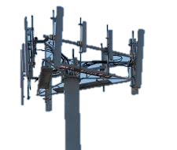
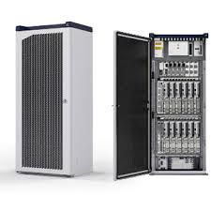
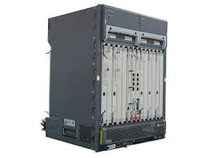
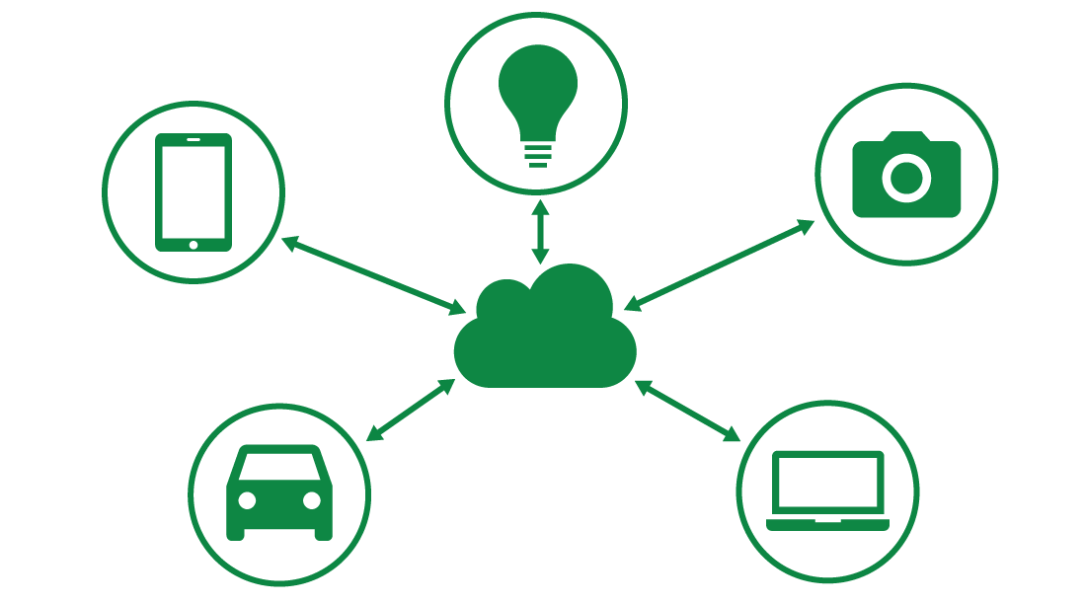
M-CORD Drivers = Operator Challenges
In the last 5 years
100,000%
Increase in Wireless Data Traffic
$50 Billion
Spectrum investment
(~50 Mhz)
$5 Billion
LTE System investment
(RAN, EPC)
Alternative “shared” access
(WiFi, LAA, LTE-U)
New and very diverse devices with IoT
Vendor
Lock-in Interfaces
Slowing revenue growth

Slide 30
M-CORD Drivers: Proprietary to Open
State of the infrastructure: Built with closed proprietary boxes
Inefficient utilization including sub-optimal use of precious radio resources
Inability to customize for various customers
Slow in creating innovative services
Cannot support industry-specific IoT scenarios
Mobile infrastructure needs re-architecting
– To enhance Mobile operators’ competency

Slide 31
About MCORD
Mobile CO Re-architected as DC
Economics of DC
Infrastructure mainly built with commodity H/W and white-boxes
Agility of a Cloud provider
Software platform that enable rapid creation of new services
Mobile Edge
Provide services at the edge of network to leverage the Benefits of;
Proximity to Users
Reduced latency, Reduced backhaul load
Utilizing information related to Radio Resource
Micro-services
Provide services and infrastructure well suited for the targeted enterprise;
Lightweight platform on-demand
Independency and autonomous control in accordance with centralized orchestration
Enterprise specific SLA
Notes:
MCORD is all about opening up the interfaces ad enabling innovation by all

Slide 32
M-CORD Guiding concepts
SDN/NFV
Open source
Open interfaces (RAN/Core)
Open platforms
Commodity hardware
Programmability
Observability
Service assurance, Performance
Coexistence with existing infrastructure
Notes:
Read the bullet

Slide 33
Capabilities to be Explored on M-CORD
Enhance resource utilization
Real-time resource management
Exploit multiple Radio Access Technologies
Real-time analytics framework
Provide customized services and better QoE to customers
Customized service composition
Differentiated QoE based on service requirements: latency and throughput
Enable use cases: IOT, smart cities, hospital, education, industrial M2M apps
Agile and cost-efficient deployment
On-demand deployment
Virtualized /disaggregated RAN and EPC
Commodity H/W and open source
QoE: Quality of Experience, RAN: Radio Access Network, EPC: Evolved Packet Core

Slide 34
M-CORD: Best of Mobile + CORD
SDN Control Plane - ONOS
NFV Orchestration w/XOS
Disaggregated/Virtualized RAN
Disaggregated
/Virtualized
EPC
Mobile Edge
Services
SDN Fabric
+
BBU, RRU
front haul fabric
MME, SGW, PGW
Caching, SON, Billing
Commodity servers, switches, network access
Platform for next gen mobile services + Software defined RAN

Slide 35
M-CORD Software Architecture
Operator Specification (TOSCA) + GUI
CORD Controller
Service Graph
Resource Policy
Scaling Policy
Customer Policy
Mobile
Subscribers
Controller
vMME
Controller
Controller
Controller
RRH
vBBU
vSGW
vPGW
Controller
Controller
Controller
Controller
OpenStack
ONOS
Monitoring
vCDN
Everything-as-a-Service(XaaS)
CORD Controller consolidate all configurations and control
CORD Controller mediates all inter-service dependencies

Slide 36
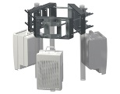
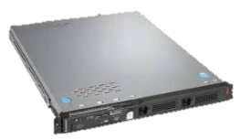
M-CORD Architecture Framework
Disaggregated/Virtualized
RAN
Disaggregated/Virtualized
EPC
Mobile Edge
Services
XOS (Service Orchestration)
OpenStack
RAN/EPC Control Agent
VTN
Control APPs
ONOS (Networking)
Nova
Ceilometer
Neutron
5G Capabilities to be Explored on M-CORD
Leaf-Spine
Fabric
White Box
White Box
White Box
White Box
White Box
White Box
White Box
White Box
White Box
White Box
White Box
White Box
White Box
White Box
White Box
White Box
vPGW-C
MME
PCRF
PGW
vBBU
vMME
vSGW
Content
Caching
RRUs
vPGW-D
EPC Control
Functions
Centralized
EPC
[ M-CORD mobile edge ]
[ Mobile Core ]
Notes:
CORD environment

Slide 37
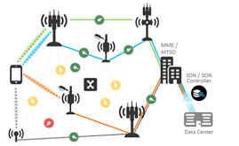
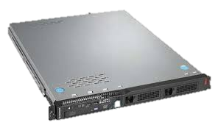
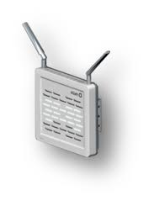
Mobile CORD POC (March 2016)
POC at ONS 2016
Service Provider View
Caching Service
Monitoring Service
eSON Service
BBU, MME,
SGW, PGW
Services
Enterprise
Customer View
ONOS + OpenStack + XOS
CORD
Fabric
TeraVM
INTERNET
XOS
UE1
UE2
MME
vPGW-C
ONOS
vBBU
vPGW-D
Content
Caching
vSGW
OpenStack
RRUs
Commodity Servers, Storage, Switches, and I/O
Notes:
Now let me describe the set-up for the CORD POC demo.
On the right is a proof-of-concept central office re-architected as datacenter. The infrastructure is comprised of commodity servers. Three open source platforms control, configure and manage the infrastructure and services – ONOS – the SDN Control Plane, Openstack – which manages VM’s and XOS- a cloud operating system built on Openstack that provides the overarching service management platform. As you can see, the proprietary boxes are disaggregated and their functions are instantiated either as services on commodity hardware or as control applications on ONOS. What’s also interesting here is that the OLT box is disaggregated into a standalone OLT MAC and the remaining functions of the traditional OLT are virtualized.
On the left, is the subscriber home. The complex CPE that typically resides in the subscriber home is replaced with a simple Netgear box with Open WRT software.
All the complex functions of the CPE are virtualized and moved to the Telco Central Office
<click for animation – sckipio part will appear>
The demo set-up includes two access technologies – GPON with openflow enabled GPON OLT MAC and open-flow enabled G.fast bridge with GPON, in effect highlighting that CORD is applicable to a diversity of access technologies.

Slide 38
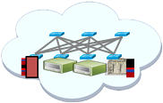
M-CORD Service example: Video from the Edge
M-CORD
mobile edge
Non-local service
PGW
INTERNET
Central/Core DC
M-CORD
mobile edge
Local service
Local service : UE1 vBBU vSGW local-PGW
Non-local Service : UE2 vBBU vSGW global-PGW

Slide 39
Expected Service Opportunities on M-CORD
m-Health
Platform for Mission-critical IoT
Connectionless services for Massive IoT
Network Slicing for new services of diverse SLAs
Analytics and Security

Slide 40
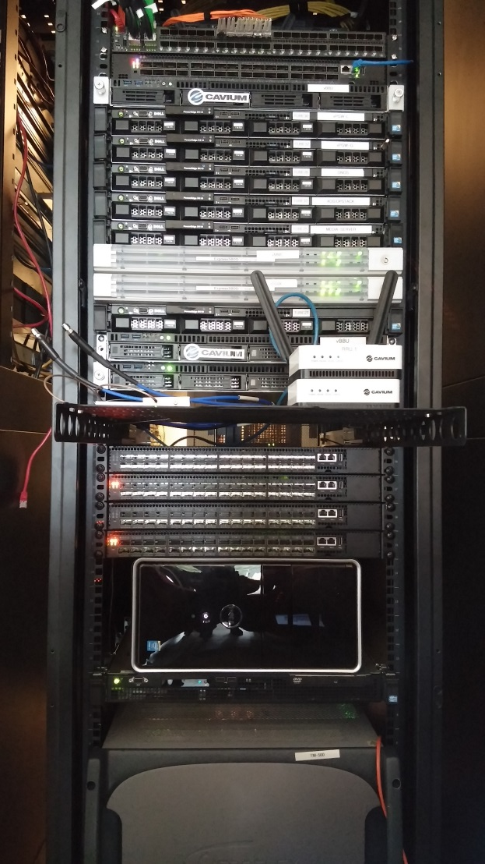
M-CORD PoC: Infrastructure & Collaborators
vBBU
RRU
vPGW-C
vPGW-U
vMME
vSGW
ONOS
XOS
eSON
UE, App
Emulator
[ M-CORD POC Rack ]
RRU: Remote Radio Unit, (v- : virtualized), vBBU: Baseband Unit, vMME: Mobility Management Entity, vSGW: Serving Gateway, vPGW-C/D: PDN Gateway Control plane/Data plane, SON: Self Organizing Network
Notes:
Rack 1 demoed at ONS

Slide 41
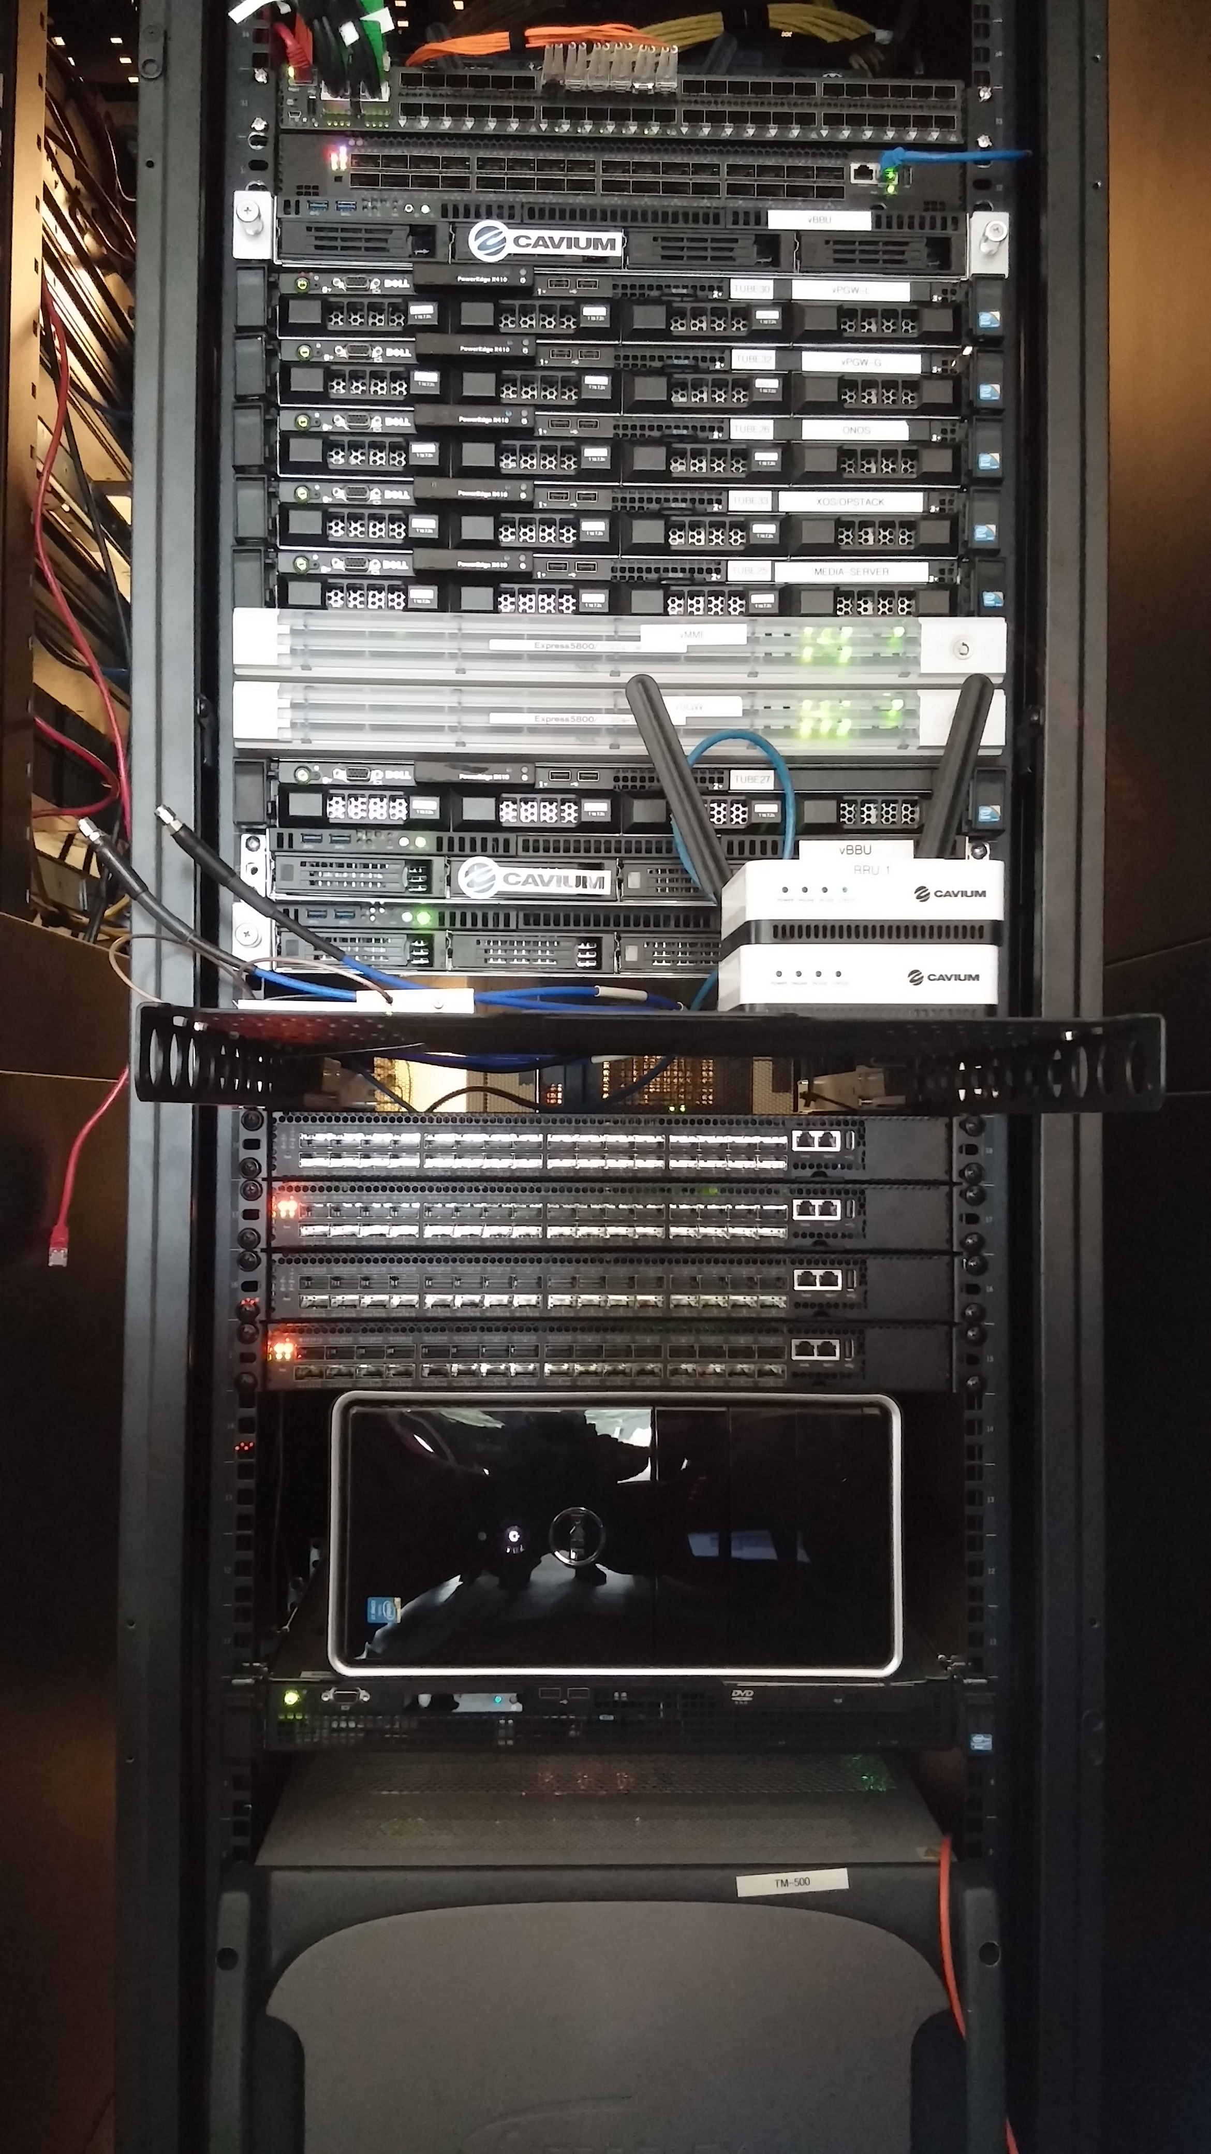
M-CORD Next POCs Goal
Next POCs with
Enhanced integration
New features
New use cases
+
Success criteria
Abstractions
Slicing
Programmability
Open interfaces
Performance
Valuable edge services
5G Technology building blocks and Use cases
+ New collaborators
M-CORD POC (at ONS 2016)

Slide 42
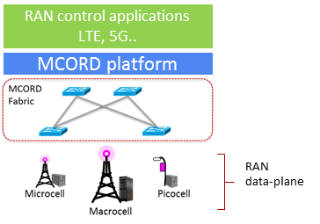
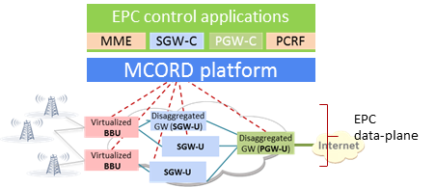
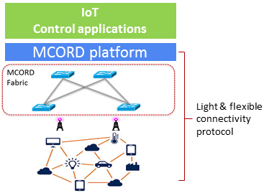
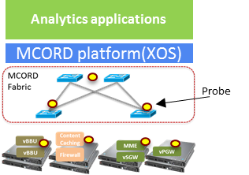
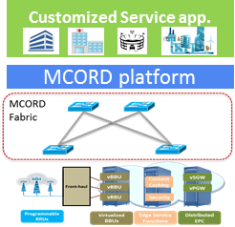
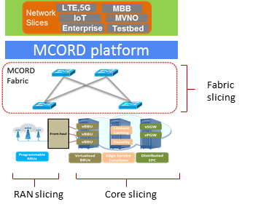
M-CORD Proposed Expansions
RAN disaggregation
EPC disaggregation
Connectionless services
Real-time analytics
Edge services
Network slicing

Slide 43
Work areas for next M-CORD PoC
M-CORD control platform
Low Latency, QoS & Fabric Slicing, Analytics, Security
Mobile Infrastructure
RAN: Multi-RATs, Disaggregation, Split Architecture, Slicing, SON/Analytics
EPC: Disaggregation, Slicing, Policy & Charging
Connectionless service (Non-GTP based)
Services
M-Health, IoT, VR/AR

Slide 44
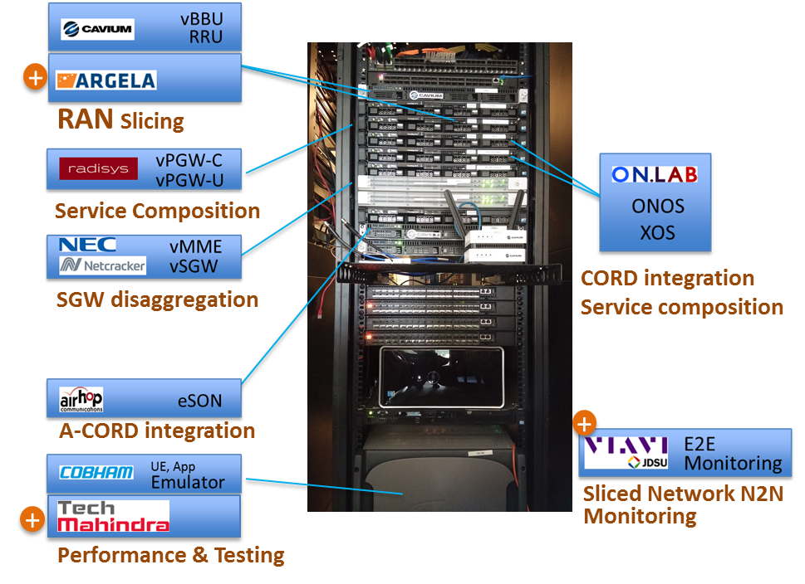
M-CORD Network Slicing
Rack#1 : M-CORD Platform Integration + RAN Slicing
M-CORD Platform Integration efforts
vBBU, vPGW services on XOS
Fabric integration
HSS integration
Testing and Performance ◄ w/ Tech Mahindra
New PoC : ‘Network Slicing’
RAN slicing porting to ONOS ◄ w/ Argela
E2E monitoring ◄ w/ Viavi
Network cookie* based application classification and applying RAN slicing rule
m-Health
※ EPC slicing is under exploring

Slide 45
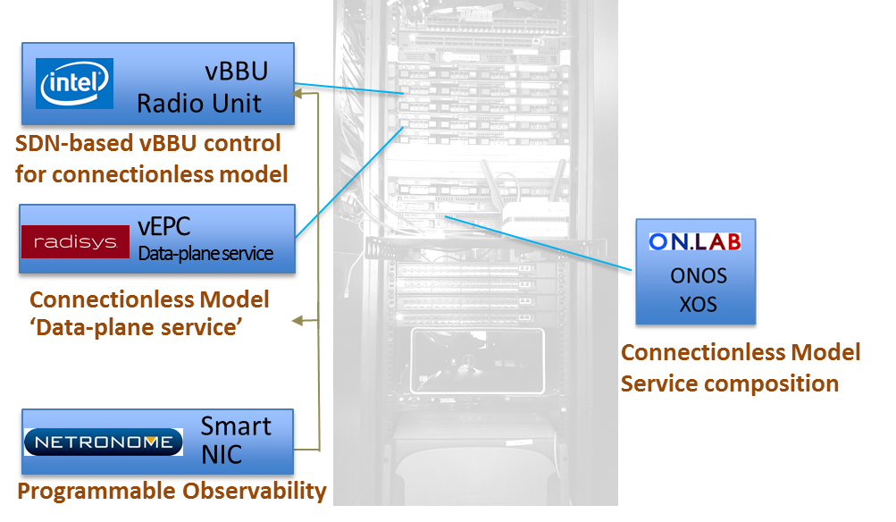
M-CORD Connectionless Service
Rack#2 : Connectionless Service
New PoC: Connectionless Service
Non-GTP based Light connectivity ◄ w/ Intel, Radisys
Initially, targeting for static devices
Mobility support will come later
SmartNIC for programmable analytics ◄ w/ Netronome, Cavium
Massive IoT use cases
Rack#2 is
on its way

