Slide 1
Mobile-CORD Progress and MWC Plan
Notes:
M-cords to bring best practices of CORD to provide programmable mobility in a box
RAN and EPC virtualization methodology utilizing CORD Architecture
Disaggregation of data from control plane and collapsing the EPC data plane into CORD fabric and collapsing the control into ONOS s applications for 5G
Set up M-CORD ( Mobility in a box) wireless networks of any kind anywhere
Provide M-CORD in a BOX for enterprise solutions such as hospitals ad Educational and infrastructure markets
Affordable mobile wireless broadband to the rural & developing world
Utilize the Unlock unlicensed spectrum for providing fixed broadband access ( mm Wave)
Build M2M solutions for asset tracking using satellite and other available communications links
Simultaneous connectivity across 5G, 4G and Wi-Fi ( Multi-RAT)
Hybrid 4G and 5G radios (LTE, 5G NR, Wifi, mmWave/beam forming )
Highly modular and low cost based on commodity HW/SW
M-cord to address all mainstream 5G wireless standards and frequencies
Completely Open Source, Hardware and Software that is not locked to any specific vendor or expensive HW/SW including smart NICs and acceleration techniques
The Case for Open Source Deployments for democratization of wireless interfaces
Dynamic front haul split architecture utilizing (option ?, and option ?) based on 3GPP recommendations
Simplify core networks and minimize the need for GTP-tunnels /tunnel less
Support for densification of small 5G cells and carrier aggregation
Provide programmability ( Configuration, forwarding, analytics) for RRU, BBUs, and Core
Seamless On-Boarding of VNFs, Application and services
Provide E2E network slicing

Slide 2
Progress Update (October 21st )
RAN Slicing
CORE Slicing
RAN Slicing – Demoed
RAN Slicing manager integrated with ONOS in progress
- RAN Slicing/Control agent on Cavium‘s LTE stacks: done
Virtualized BBU Service for Cavium’s stack in XOS - completed
Studies on RAN Split architecture options and SDN control for MWC in progress ( need requirements / Collaboration)
Looking for nFAPI open APIs and or Open source
Discussion with OAI in progress
CORE Slicing – Partially finished
CORE Slices currently using Quortus vEPC
w/ flexible composition of vEPC components
Quortus VNFs are installed in ON.Lab Rack
Build multiple E2E slices– Done
XOS service composition vEPCs – in progress
Utilizing Radisys vEPC as independent and/or mixed Slice is under planning ;
Training on Radisys EPC scheduled for next Wednesday
E2E Slicing Demo:
https://www.youtube.com/watch?v=Kw1HuGe7ZuE
Current Activities:
E2E Slicing Integration with rest of the sub-systems in progress
Active testing (integrated with XOS) Independent demo
Public safety app. classification using Network Cookies ( in progress )
E2E Sling (RAN Slicing + CORE Slicing) : Done

Slide 3
Solution Status
Ready
Preparing
M-CORD Platform
Service On-Boarding
app
SON
Network
Cookies
RAN
Slicing
CN
Slicing
Dynamic
Analytics
Link
Aggregation
CORE
Open Source (?)s
Quortus
Mixed Open
Source & Quortus
Radisys / Google
Virtual EPC Components
Open source
Virtual EPC Components
Disaggregated MME
Based EPC
Disaggregated MME
RAN
Cavium CRAN
Intel + Radisys
SAS Based RAN
OAI RAN (?)
SDR Lime based
USRP based
Multiple Splits
L1 in Software
Connection-Less
CBRS

Slide 4
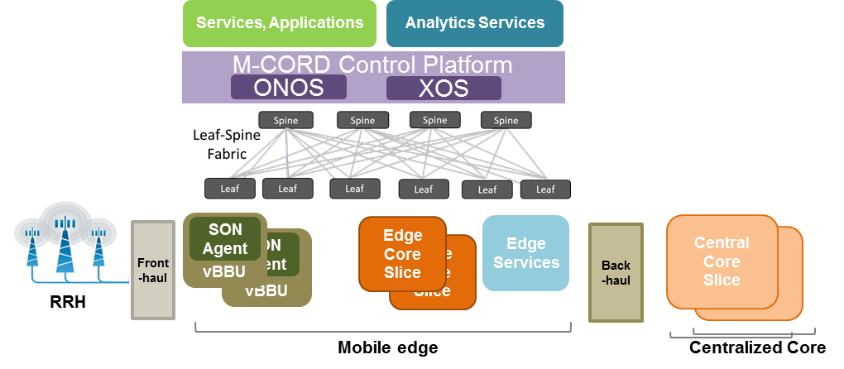
MWC Working Groups
M-CORD Architecture for 5G
Members: On.lab, AT&T,VZ, SK, Google, Prof. Paulraj
ONOS, XOS Roadmap
M-CORD Federation
Use cases
Influencing SDO (3GPP,IEEE, ONF)
G#2: Mobile Core
G#1: Platform & Apps.
Members: Radisys, Argela, Google
UP/CP disaggregation
MME disaggregation
Core Slicing
IoT, Connectionless (Intel) (RAN comes later)
Members: On.lab, Ericsson, Viavi
Service On-Boarding & Orchestration
A-CORD, Active test as-a-Service, SON
Public safety app.(xpose) (w/ NW cookies, Yiannis)
G#3: C-RAN
G#6: E2E System Testing
Members: Cavium, Argela
RAN Slicing
Multiple RAN Split options (2,4,etc.)
Members: IXIA?, Cobham ,Techmahidra
E2E Testing, Interoperability
KPI matrix, Testing Scenario
Group#4: NGFH
G#5: Acceleration, SmartNIC
Members: Cavium, Xilinx, Argela, Fujitsu(w/ HFR), Micro-semi
nFAPI compatible
CPRI over Ethernet, RoE
Wireless back-hauling, Mesh
Members: Netronome, Xilinx, Cavium
Acceleration as-a-Service
Smart Virtual Probes
Show Benefits
System Integration
Members: Radisys
Release management
M-CORD mini

Slide 5
Project Planning ( Please update )

Slide 6
5G Architecture (Prof. Paulraj, AT&T,VZ, SK, Google,)
M-CORD road maps and Architecture Influencing SDO (3GPP,IEEE, ONF)
ONOS, XOS and NB interface Roadmap
M-CORD Federation
Use cases and demos
Current Status:
Dependencies:
Asks:

Slide 7
G#1: Platform & Apps. ( On.lab, Ericson, Viavi)
MWC Project Goals;
Mobility Infrastructure Service On-Boarding & Orchestration utilizing XOS Environment
Integration of A-CORD,
Integration with Active test as-a-Service,
Application On Boarding
Integration of Public safety app.(Xpose) (w/ NW cookies, Yiannis
eSON
Current Status:
Dependencies:
Asks:

Slide 8
G#2: Mobile Core (Radisys, Argela, Google)
Members: UP/CP disaggregation
MME disaggregation
Core Slicing
IoT, Connectionless (Intel), RAN support for connectionless later
Current Status:
Dependencies:
Asks:

Slide 9
G#3: C-RAN (Cavium, Argela)
RAN Slicing
Multiple RAN Split options (2,4,etc.)
Current Status:
Dependencies:
Asks:

Slide 10
Group#4: Next Generation Front Haul (Cavium, Xilinx, Argela, Fujitsu(w/ HFR), Micro-semi)
nFAPI open sourced based on specification
CPRI over Ethernet, RoE
Wireless back-hauling, Mesh
Current Status:
Dependencies:
Asks:

Slide 11
G#5: Acceleration, SmartNIC (Netronome, Xilinx, Cavium)
Acceleration as-a-Service
Smart Virtual Probes
Show Benefits
Current Status:
Dependencies:
Asks:

Slide 12
G#6: E2E System Testing : M-CORD Scaling (IXIA?, Cobham, Techmahidra)
System Test ( Scaling, Performance, Conformance, ….)
System E2E Test plan, tools, scripts,
Interoperability, certifications, VNF onboarding validation
KPI matrix,
Testing Scenario
Etc…
Current Status:
Dependencies:
Asks:

Slide 13
Group 7 ; Integrator (Radisys)
Release management
M-CORD mini
Current Status:
Dependencies:
Asks:

Slide 14
Plan for MWC `17
Schedule (Sample)
14 Oct.
30 Oct.
15 Dec.
15 Jan. `17
30 Jan `17
15 Feb `17
∙ Confirm Project Scope
∙ Build team & agile work process
∙ CORD Integration
- XOS, ONOS, OpenStack
- RAN Slicing + Core Slicing
∙ CORD Integration
- E2E Slicing w/ disagg. MME
- XOS service, ONOS, Fabric
∙ Total Integration
- Ready for MWC `17
- E2E Slicing w/ disagg. MME
- XOS service, ONOS, Fabric
- Active testing (Observability & Analytics)
- Public safety app.
- Connectionless
+
∙ MME disaggregation - architecture
∙ MME disaggregation - implementation
∙ MWC Logistics
+
+
Existing Roadmap work
∙ Active testing
∙ Link Aggregation (WiFi, LTE)
. RAN Splits options
∙ Connectionless
∙ Public safety app. Classification (using Network Cookies) + QoS handling

