Slide 1
MME ARCHITECTURE & DESIGN

Slide 2
Existing Design
S6A-APP
MME-APP
S1AP-APP
S11-APP
Notes:
There are 3 network processes : s1ap-app, s6a-app and s11-app
Mme-app is the core app which handles all the user context and procedures.

Slide 3
MME-APP : Attach
Stage 1
Stage2
Stage3
Stage4
Stage8
Stage7
Stage6
Stage5
Stage1 | Stage2 | Stage3 | Stage4 | Stage5 | Stage6 | Stage7 | Stage8
Receive InitUE + Send AIR | Receive AIA/ULA + Send Auth Req | Recv Auth Rsp + send SMC | Recv SMC Rsp + Send ESM Info Req/Send CSR | Recv ESM Info Rsp + send CSR Req | Recv CSR Rsp + Send ICS Req | Recv ICS Rsp & Attach complete + Send MBR Req | Recv MBR Rsp + finish Attach proc

Slide 4
MME-APP : Detach
Stage 1
Stage2
Stage3
Stage1 | Stage2 | Stage3
Receive Detach + send DSR to S11 + send Purge to S6a | Recv Purge Rsp + Recv DSR rsp + send Detach accept & Context release | Recv Context release
Current Design has 8 Stages for Attach and 3 Stages for Detach

Slide 5
MME-APP : New Stage Design
The new design suggested divides the mme-app process to have 6 Stages.
The stages are common for all procedures.
Each stage will have its own queue and a pool of threads for each queue.
The stages are :
MME core handler Stage : AMF
HSS Interface Stage : AUSF
Security Context Handler Stage : AMF
S10 Context Handler Stage : AMF
Session Management Stage: SMF
Database Manager Stage : UDM

Slide 6
MME-APP : New Stage Design
MME Core Handler Stage | HSS interface Stage | Security Context Handler Stage | S10 Context Handler Stage | Session Management Stage | Database Manager Stage
1. Recv request Initiated from S1AP, S10, GTP and S6a and will forward to corresponding stage queues. 2. It will handle timer expiry messages and forward to stage queues as per timer type. | AIR/AIA,ULR/ULA, ISD,DSD messages handled in this stage | Manages the procedures for UE security context including Authentication and SMC procedures. | Manages Handover requests and TAU context requests. | 1. Handles the Session Management procedures. 2. The S11 stage and Context setup/update stage can be substages for this. 3. The S11 stage can handle interaction with SGW. 4. The Context setup/update stage can handle interaction with ENB. | Handles updates to session store.

Slide 7
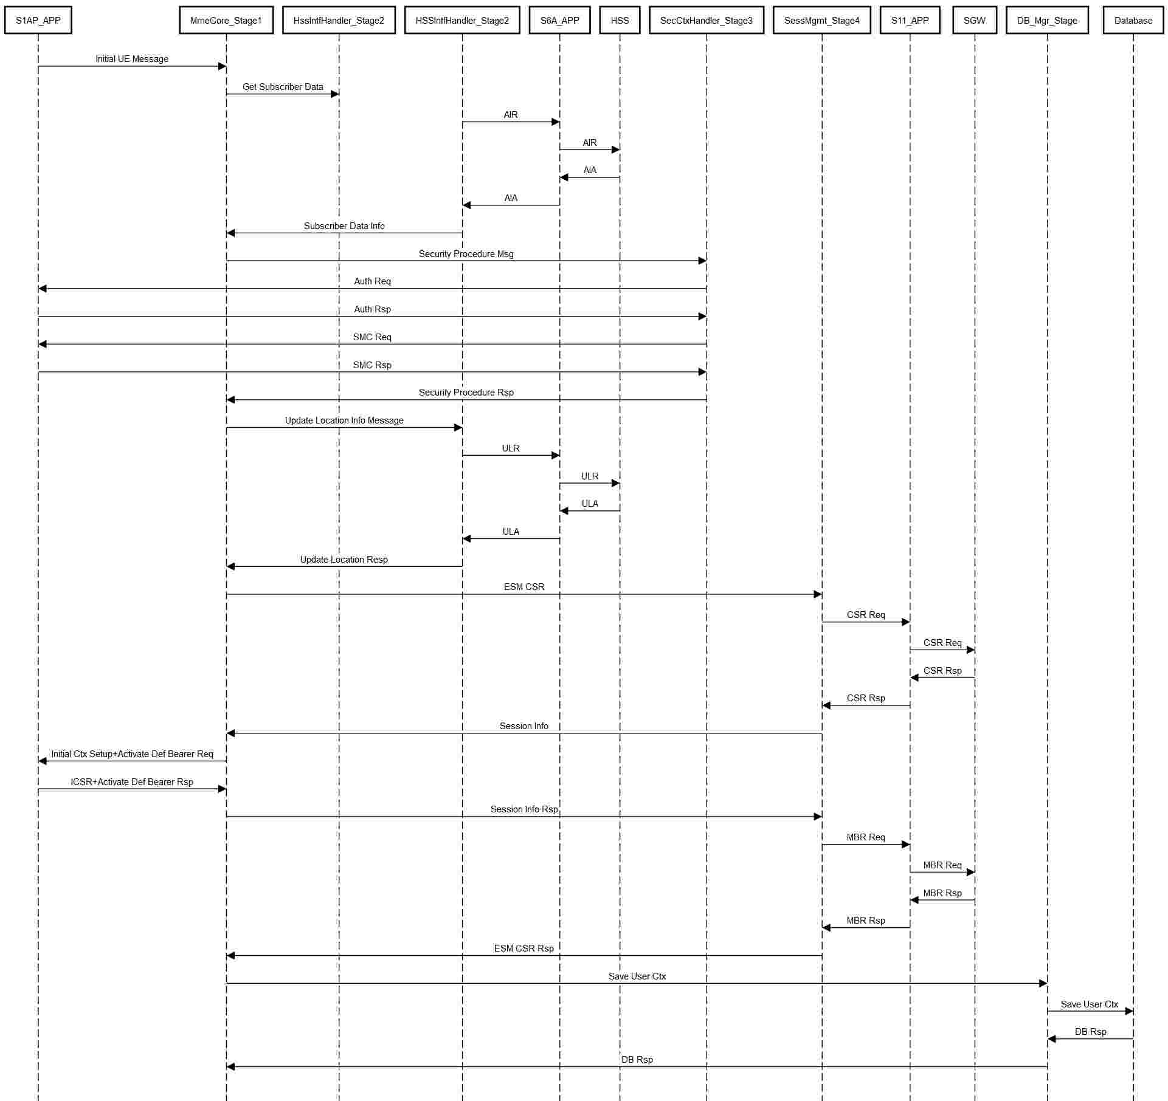
Attach Procedure flow through Stages

Slide 8
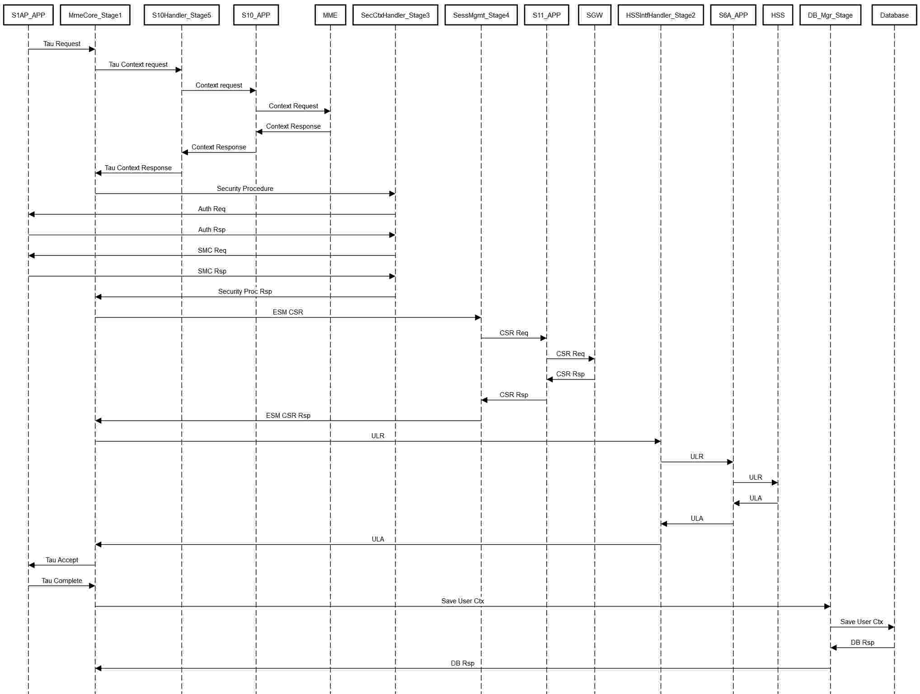
TAU Procedure flow through Stages

Slide 9
UE Context and States
MME-Core Stage to keep State FSM
All other interfaces entities to keep transactions. And take care of retransmission.
Type of procedures
Access Initiated Procedures
HSS initiated procedures
Core initiated procedures
UE Context maintains the following list of procedures:
Active Procedures
Suspended Procedures
Pending Procedures

Slide 10
UE EMM States
RegisterInitialized
AttachSuccess
AttachReq
AttachFaillure
Deregistered
Registered
DetachReq
DetachSuccess
DeRegisterInitalized

Slide 11
Event Processing
Perform message level validation. Validate certain fields in the message based on message/event type. No subscriber required for this type of basic validation.
Find the subscriber in the cache using the id found in the message. Id depends on message type.
If not found then get the subscriber from the database
If subscriber not found then create subscriber or reject message
Subscriber->getCurrentEMMState()->handleEventX(subscriber, message)
Reject/drop the message in bad state and log the message
Perform advance validation on the message. Message content can be validated against the subscriber content.
Create Procedure. Copy/set the references in the procedure.
Subscriber->startProcedure(proc);
Add the proc if no proc is active. Or add the proc the in pending list if cant started right away. Proc->startProcedure()
Procedure moves through multiple states depending on the procedure type. Once procedure is finished feedback is given to the subscriber/pdn/bearer fsm that procedure is finished. Once procedure is finished, start pending procedure if any.
After procedure is finished we can save subscriber to database/external-storage.

Slide 12
Procedures
Procedure is the class/structure which holds all the temporary information. And once procedure is finished, its content is saved from procedure to subscriber.
Procedure is something which moves from one state to other. Once procedure is finished, subscriber data is updated based on the procedure output.
Typically single procedure may lead to multiple procedures and keeping parent/child relation in the procedure helps. Parent waits for all child procedures to be finished.
After every proc is finished, give feedback to parent procedure if any or feedback is given to subscriber about the completion of the procedure. This causes procedure to terminate and take up other procedure for execution.
If any procedure fails then perform failure action by doing local action. Procedure failure may trigger subscriber cleanup or just rejection of the procedure by sending reject response.

Slide 13
Attach Procedures (Parent Procedure)
Create Child Procedure:
Subscriber Data fetch procedure
Security Procedure
Update Location Procedure
Session Management Procedure
Attach Procedure States :
Idle
WaitForSubDataFetchProcRsp
WaitForSecurityProcRsp
WaitForUpdLocProcRsp
WaitForAttachComplete
WaitForSMProcRsp
Active

Slide 14
Attach (Parent Procedure)
WaitForSecurityProcRsp
WaitForSubDataFetchProcRsp
WaitForUpdLocProcRsp
init
WaitForAttachComplete
Active
WaitForSMProcRsp
Notes:
Child Procs : Identity Proc, Security Proc, ULR proc

Slide 15
Authentication Procedure(Child Procedure)
AuthRspPending
Failure
Init
Success
SmcRspPending
Success/Failure

Slide 16
ULR Procedure (Child Procedure)
Init
ULAPending

Slide 17
Other Suggestions
The Inter-stage communication should be updated to GRPC or REST Based APIs.
The N-26 Interface can be added to interface with 5G AMF.
Service Based Architecture Framework.
ASN Based Encoder/Decoder.

