Slide 1
Mobile CORD (M-CORD)
Cavium M-CORD pod demo @ MWC Americas
September 7, 2017

Slide 2
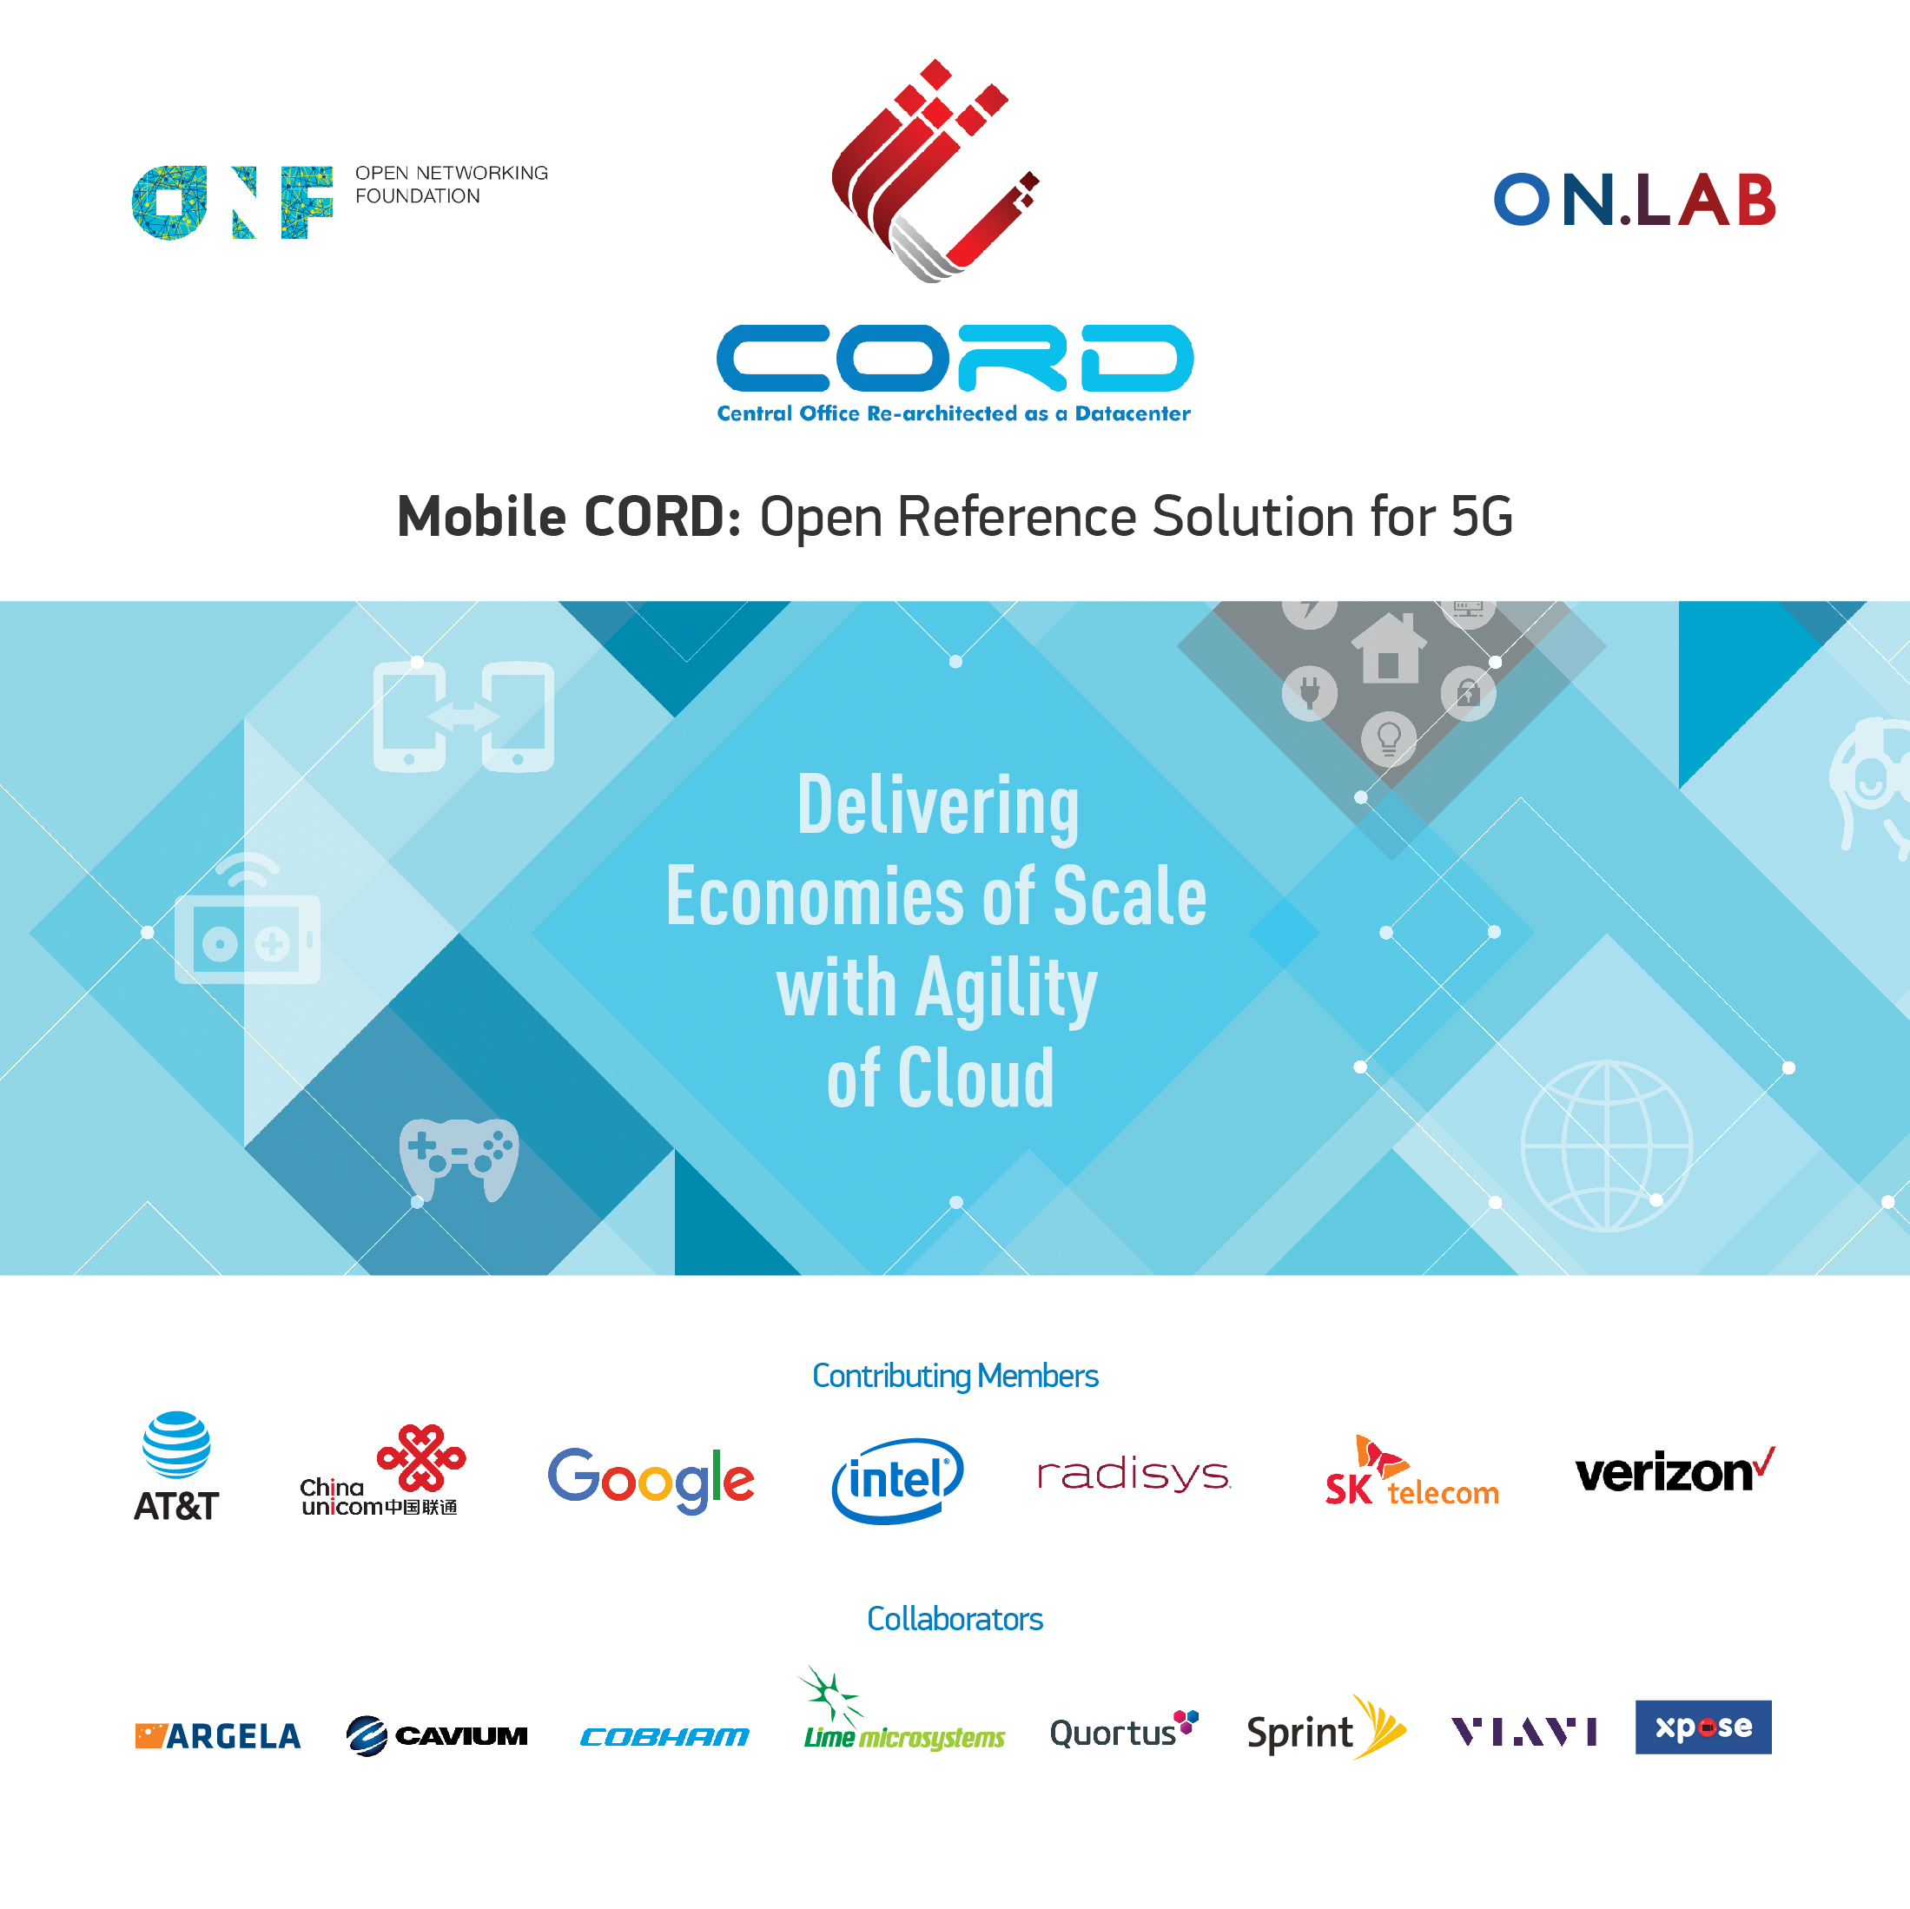
Mobile CORD (M-CORD) @ MWC 2017
Notes:
M-CORD has a growing and vibrant community.
It includes leading service providers such as AT&T, China Unicom, Google, SK Telecom and Verizon. These providers are providing significant funding, people, use cases and wanting to do lab trials.
Our partners that actively contribute to M-CORD include Intel and Radisys.
And then we have a long list of companies as collaborators that have been actively contributing to M-CORD and these include Argela, Cavium, ….
We have exciting community and we are grateful for their contributions.

Slide 3

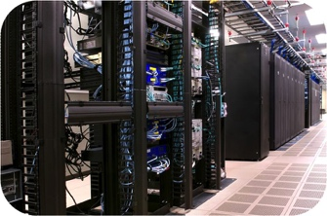
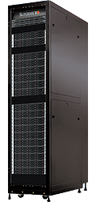
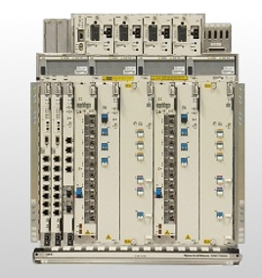

CORD (Central Office Re-Invented as Data Center)
High Level Architecture
SDN Controller
ONOS
VNF/Services Mgmt. XOS
Large number of COs
Leaf-Spine
Fabric
White Box
White Box
White Box
White Box
Cloud
SDN enabled Central Office Fabric
SDN
NFV
White Box
White Box
White Box
White Box
White Box
White Box
White Box
White Box
White Box
White Box
White Box
White Box
Evolved over 40-50 years
(Core)
Access
300+ Types of equipment
Huge source of CAPEX/OPEX
Commodity servers, switches, and network access
Notes:
Central office needs to be reinvented because the economics have outgrown its functionalities and innovativeness. Over the 40-50 years, typical CO have spun over 300 different devices that are mostly closed, proprietary and unprogrammable.
As the highest source of capex and opex, the current CO now becomes detrimental to innovation. It’s rigid infrastructure limits service providers’ ability to create new services for its customers.
CORD brings a fresh approach to rearchitecting the central office. It brings together SDN, NFV, and Cloud technologies and approaches.
In terms of hardware, we have a fabric at the center that interconnects everything within the CO. The fabric has the standard leaf-spine architecture built using OpenFlow-enabled white boxes.
This fabric interconnects a set of server racks – they host VNFs implemented in VMs and containers; cloud and other services – potentially for 10s of thousands of customers. These servers are standard commodity servers – OCP servers.
What is unique about the central office is the access racks. A typical data center may have few fibers coming in but that is all. A CO as I mentioned terminates 10K or more residential and 10K or more mobile and 1000s of enterprises. And these access devices are the ones that contribute to high capex and opex and lack of innovation. In the case of CORD we want to build these access racks with the same philosophy – use merchant silicon, white boxes and open source.
Then we have two control planes: one for all the networking that is SDN based and we use ONOS and a set of services on ONOS to realize it.
We have another control plane that manages virtualization, services and service composition. It is realized using OpenStack, Docker and a platform we built called XOS – it acts as an overall CORD controller and also a service orchestrator.

Slide 4
Domains of Use: Residential, Mobile, Enterprise
Residential
vOLT, vSG, vRouter, vCDN
Mobile
Disaggregated/Virtualized
RAN & EPC,
Mobile Edge Service
Enterprise
SDN-WAN with programmability,
packet-optical convergence
ONOS + Trellis+ XOS + OpenStack/Docker
Leaf-Spine
SDN Fabric
ROADM
(Core)
Enterprise
Metro Ethernet
BBUs
(Multi-RATs)
PON
OLT MACs
Commodity Servers, Storage, Switches, and I/O
Notes:
Over the past year or so, we have demonstrated that the CORD platform can support three domains of use: residential, mobile and enterprise.
In the case of residential, we demonstrated how access rack for GPON can be built with merchant silicon and white boxes and how we can extract control and implement it as a service on top of ONOS – called vOLT. We also implemented other services such as vSG, vRouter, and vCDN as services on our software stack.
We also demonstrated how we can support mobile customers with disaggregated and virtualized RAN and disaggregated and virtualized EPC implemented as services. We also show some mobile edge capabilities.
Finally we showed how the CORD Platform can be used to support enterprise customers. They can create virtual networks on demand, add value-added services to their virtual networks and observe and control their networks.
You will hear talks on each later in the day.

Slide 5




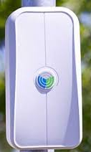





M-CORD POD + CORD Fabric
SDN managed
SDN Fabric
Spine switches
XPliant
XPliant
Front-haul Switch
Leaf switches
XPliant
XPliant
Front-haul
Management Switch
vBBU
RRU
(Remote Radio Unit)
Head / Control node
Compute node
vEPC
vMEDIA
Compute node
M-CORD Rack #1
M-CORD Rack #2
Wireless
User Equipment
M-CORD Racks with
white box spine-and-leaf Switch Fabric and ARM servers
Notes:
M-CORD comes in these two packages:
First – we have M-CORD Mini – A turnkey POD for Easy Replication and Experimentation. M-CORD Mini is perfect as an affordable and replicable package that can be used for development, demonstrations and lab trials. This M-CORD mini includes an OCP based 2U Intel rack and Intel Compute, 40Gb Openflow enabled white box switch, and pre-validated Radio Resource Unit (RRU).
Second – we have the M-CORD POD - a carrier-grade 16U package that is based on Radisys’ DCEngine rack-scale hardware system, inspired by the Open Compute Project (OCP), yet enhanced for telco requirements and based on the OCP-ACCEPTED™ CG-OpenRack-19 specification. The M-CORD POD is suitable for demonstrating a deployment-ready M-CORD on a scalable and modular carrier-grade open hardware platform. The components can be customized with different configuration of compute, fabric, and storage requirements based on the CO needs.
The M-CORD software solution stack can be run in both of these PODs. They are suitable to run/host open source RAN and CORE as well as CORD management and controller, ONOS and XOS as well as VM or container based management such as OpenStack or Kubernetes.

Slide 6


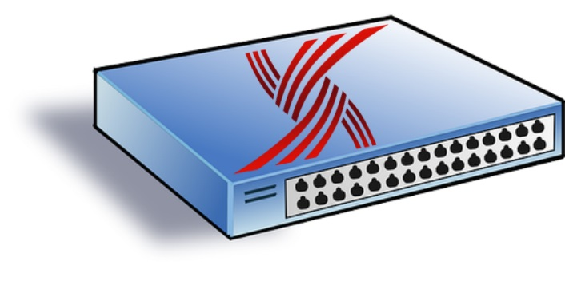
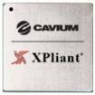
MCORD Innovations: Programmable XPliant Fabric
Seamless Integration
with ONOS 1.8
OpenFlow 1.3 Protocol Support
Flexibility to Program Switch Pipeline Protocol Processing (e.g. GTP, SRv6) Tables Scale and Advanced Analytics
1/10/25/40/50/100GE, up to 3.2T
OCP White Box
(Edgecore AS7512)
Programmable XPliant Switch
Cavium-XPliant Programmable CORD-Optimized SDN Fabric
Notes:
5G is more than about increasing the data rate. It’s also about providing common infrastructure on which new wireless services with vastly different network QoS requirements are delivered.
The 5G platform needs ability to dynamically create programmable virtual networks and differentiated traffic treatment for those vastly different use cases. This is what network slicing can provide. Unfortunately, today’s LTE does not support network slicing.
Today we demonstrate how M-CORD can provide very dynamic and programmable end to end slicing. This is possible because of
o disaggregated and virtualized RAN and EPC components
o open source building blocks for RAN and EPC that allows us to customize and modify
o software defined approach
Here are more details that show how we implement dynamic programmable end-to-end slices.

Slide 7

Cavium Xpliant Fabric Operation
SDN Controlled Programmable
Xpliant Fabric
Spine 1
Spine N
Leaf 1
Leaf N
Intra-rack traffic: L2 Bridged-Forwarded
CN 1
CN 1
Inter-rack traffic: L3 Segmented-Routed
CN m
CN m

Slide 8
Cavium-XPliant CORD Fabric Value Proposition
Cavium-Xpliant is the First Programmable Fabric available in CORD
PROGRAMMABILITY
Flexible Processing Pipeline PliantC / P4 Programming
SCALE & PERFORMANCE
Highly Scalable Solution
Performance Optimized
XPliant Fabric
EFFECTIVE HARDWARE
Leaf/Spine up to 3.2Tbps
10G/40G and 25G/100G
ENHANCED ANALYTICS
  States & Counters
  In-Band Telemetry
Read More: https://wiki.opencord.org/display/CORD/Cavium+POD

Slide 9

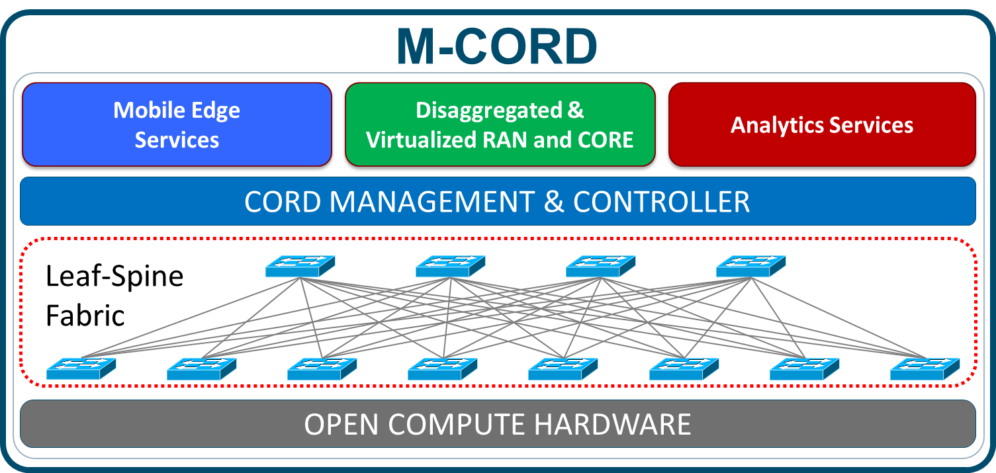
M-CORD Innovations: End to End Slicing
Network slicing
Differentiated traffic treatment for diverse devices, users, & services
Mobile Virtual Network Operator (MVNO)
REQUIREMENTS
RAN & CORE Slicing
E2E Network Slicing Orchestration
Dynamic & Programmable End to End Slicing
Notes:
5G is more than about increasing the data rate. It’s also about providing common infrastructure on which new wireless services with vastly different network QoS requirements are delivered.
The 5G platform needs ability to dynamically create programmable virtual networks and differentiated traffic treatment for those vastly different use cases. This is what network slicing can provide. Unfortunately, today’s LTE does not support network slicing.
Today we demonstrate how M-CORD can provide very dynamic and programmable end to end slicing. This is possible because of
o disaggregated and virtualized RAN and EPC components
o open source building blocks for RAN and EPC that allows us to customize and modify
o software defined approach
Here are more details that show how we implement dynamic programmable end-to-end slices.

Slide 10
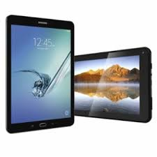
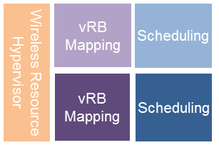
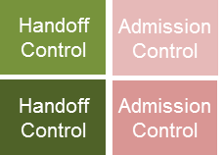

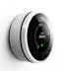




M-CORD Innovations: End to End Slicing
Wireless
Resource Blocks
1
CORD Management & Controller
4
CORE Slice 1
RAN
Slice 1
vMME
vSGW-C
vPGW-C
vSGW-D
vPGW-D
vMME
vSGW-C
+
vPGW-C
CORE Slice 2
RAN
Slice 2
vSGW-D + vPGW-D
RAN
Slice 3
vMME
CORE Slice 3
Remote Unit
Central Unit
vSGW-D
vPGW-D
Policy driven
Time
Location
Service
2
3
Dynamic composition of CORE function blocks
RAN Slicing with Split architecture
CORE Slicing
1
CORD Open Software Platform
3
  CORE Slicing
2
RAN Slicing
4
  End to End Slicing Orchestration
Notes:
Today we will show you how M-CORD achieves programmable network slicing in real time and further, while a slice is being created, modified or terminated, other slices are not impacted– thanks to the isolation of virtual networks.
Specifically – At the RAN side, the slicing includes virtualization of resource blocks – and allocating subset of these resources block onto different slices – and corresponding control functions like scheduling, handoff, admission control, etc.
On the CORE network side, slicing includes associating disaggregated virtualized EPC components to each slice
<CLICK>
The role of M-CORD is to program the slice definition and appropriately stitch the RAN and CORE slices.
<CLICK>
M-CORD allows pre-programming of a network slice with a specific start and end date/time and/or be programmed to be valid for only specific geo/location,
<CLICK>
To summarize – we have the CORD open Software Platform to enable these programmable services – which we will show through GUI.
End to end slicing – RAN and CORE
And the dynamic programmability of slicing through CORD
Unless there are any questions, let us now show you how M-CORD does this

Slide 11
Additional Resources
Icons and Slides for use

Slide 12
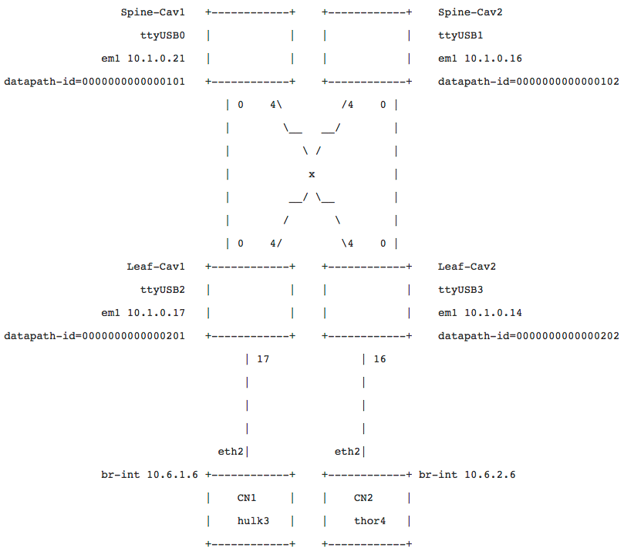
Cavium Fabric MWC Demo Topology Details

Slide 13
Cavium CORD Programmable Pipeline
CORD PIPELINE
Ingress Port
Simultaneous Tables Lookups per OpenFlow Stage
CORD Pipeline
Integrated with ONOS
Based on CROFTM
Cavium Real Open Flow
Full CORD Functionality
Performance Optimized
Scalable Tables
Extensible Feature-Set
Advanced Telemetry
Parser
Flow Classifier
Port Flow
OF
Stage 0
CVLAN
SVLAN
OF
Stage 1
TT MAC
MPLS L2
OF
Stage 2
L2 Bridging
MPLS
L3 UC Routing
L3 MC Routing
OF
Stage 3
ACL
OF
Groups
All the Groups are collapsed together:
L2, L3 UC/MC, MPLS Groups Buckets
Egress Port

Slide 14





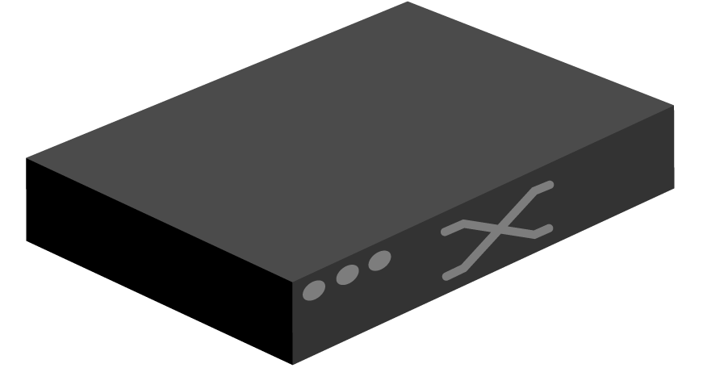
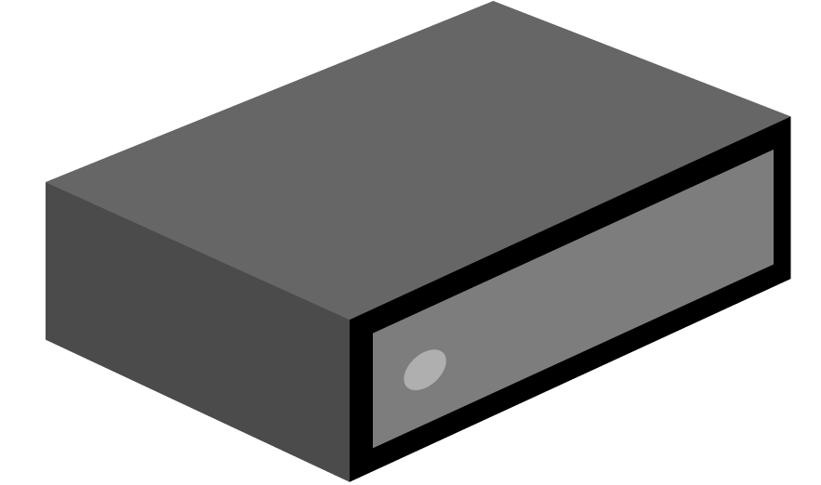




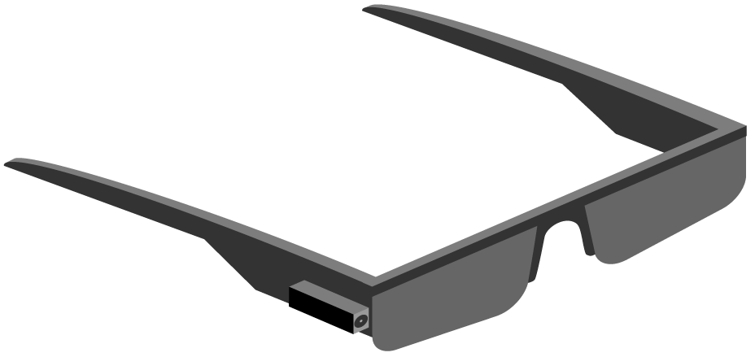
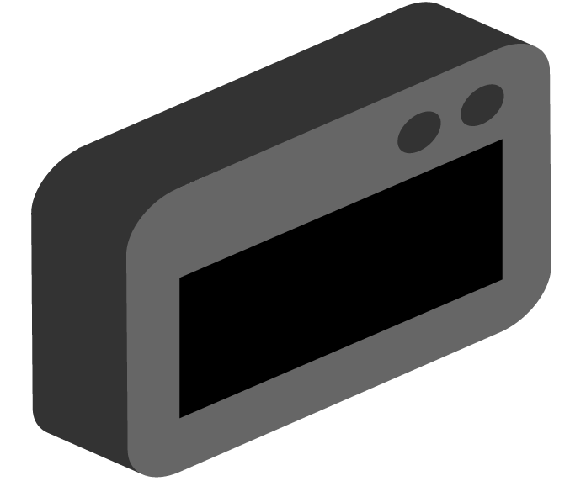

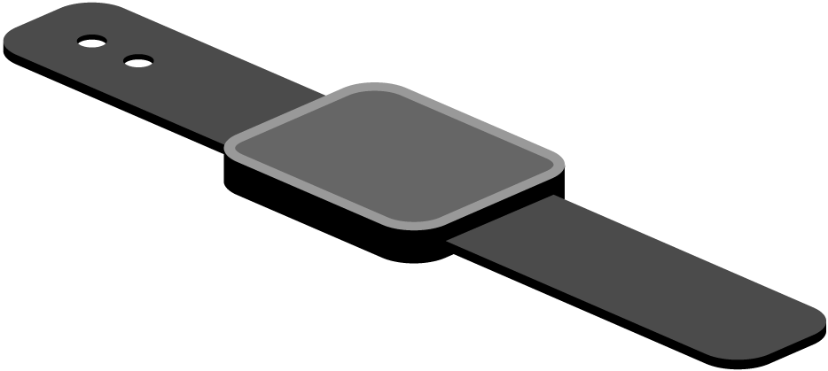


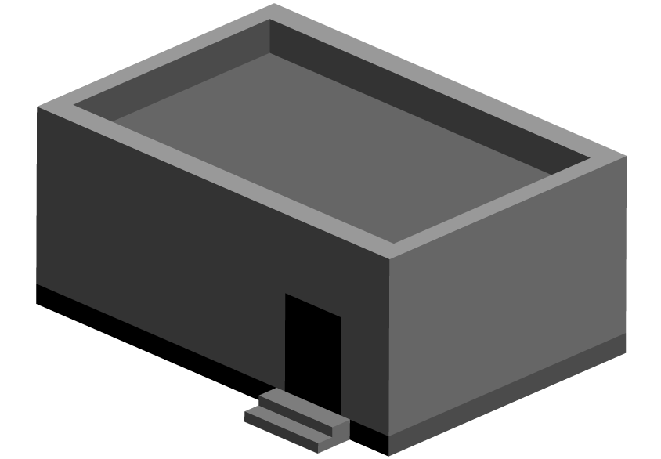


Label
Label
        Server / Server rack Switch Cell tower / Radio waves Satellite dish Drone
        Cell phone VR goggles Google glasses Smart watch Smart device Boxes & Clouds
        Building 1 Building 2 City Central office House Car

Slide 15



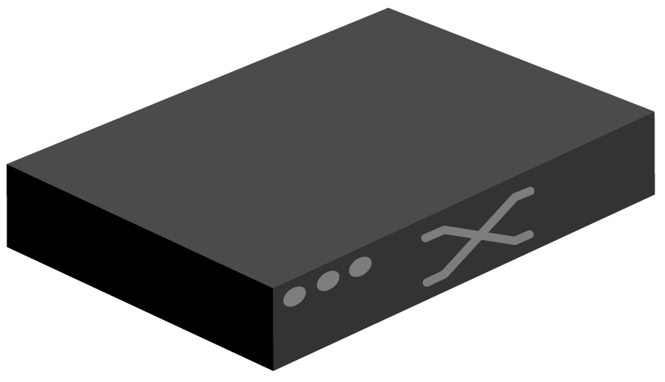

Domains of Use
Mobile
vBBU. vMME, vSGW, vPGW, vCDN
Enterprise
vCarrierEthernet, vOAM, vWanEx, vIDS
Residential
vOLT, vSG, vRouter, vCDN
Cord Controller
Metro Ethernet
BBUs
PON OLTs
ROADM (Core)

